Slide 1
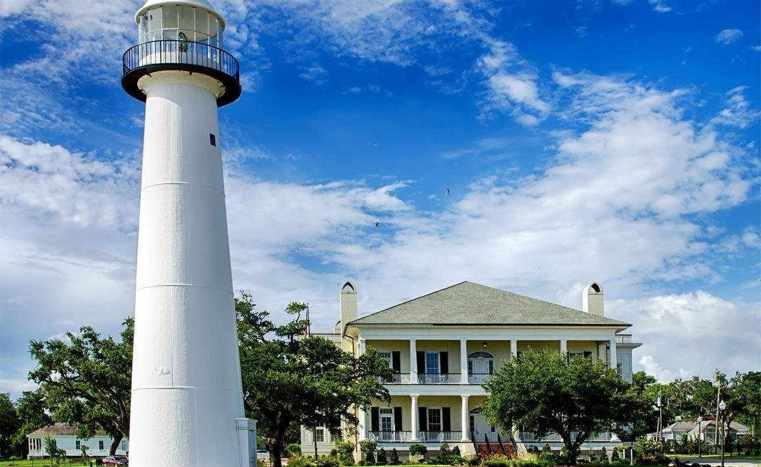
Mississippi Windstorm Underwriting Association
Understanding the Rules and Processes 2016

Slide 2
BOARD OF DIRECTORS
3 agents with at least 10 years experience
2 must be residents of the Coast
1 must not be a resident of the Coast
5 assessable insurers
Insurers that are authorized to write and engaged in writing property insurance within Mississippi on a direct basis.
2 Coast business leaders
The State Treasurer
11 Board Members

Slide 3
MWUA’s Mission
“Assure an adequate market for wind and hail insurance in the coast area of Mississippi.”
Protect policyholders state-wide from unreasonable Windpool surcharges.
Avoid damaging the state-wide market for property insurance.
Encourage better building standards and land use in the coast area in order to mitigate wind losses and depopulate the Windpool.
While accomplishing these goals, try to avoid high rates thus helping the Coast economy revive.

Slide 4
Changes- Post Katrina The Last 10 Years
HB 1500 Signed into law changing MWUA .
Stabilized the statewide property insurance marketplace
Limited Assessments to Admitted Carriers.
Provided alternative funding mechanisms.
Allows for retaining equity to buffer statewide policyholders from surcharges
ADMINISTRATIVE/OPERATIONAL CHANGES
* Geographic rating tiers – 5 rating zones
* Flood requirement for A and V zones
* Optional Deductibles – (5%, 10%, 15% & 20%)
* Fully Earned Premium Rule – Prevent Short Term Purchase

Slide 5
(CHANGES CONTINUED)
* Updated and modernized coverage forms
* Enhanced exposure data gathering to improve modeling
data – Update Inspections – Insurance to Value UW
* No Servicing Carrier – Plans System/Plans staff administer
* Commercial Deductible Changes – Explain why the change?
* Discontinue MWUA Mitigation Program/ Now IBHS Applies
Amended Mandatory Evacuation Coverage
New Requirement for Manufactured/Mobile Homes
Change coming soon – Renewal Information Applications

Slide 6
MWUA growth since 2005
AUGUST ‘05
16,155 polices
$1.8 billion insured
TODAY
33,348 policies
$5.18 billion insured

Slide 13
HOW DO WE GET CARRIERS BACK IN THE
COAST MARKET?
IMPROVE RISK AND REDUCE LOSSES
WHAT IS WIND MITIGATION ?
HOW DOES MWUA PROMOTE WIND MITIGATION ?
BCEGS
RETROFIT
NEW CONSTRUCTION
Fortification - Insurance Institute for Business and Home Safety (IBHS)

Slide 14
WHAT BCEGS DOES
BCEGS assigns each Jurisdiction a BCEGS grade ranging from 1 – 10
This is a community building code enforcement rating not a specific dwelling wind mitigation rating.
The lower the number the better the enforcement

Slide 15
WHO GRADES THESE COMMUNITIES?
The Mississippi State Rating Bureau administers both the BCEGS and the Public Fire Protection Classification Schedule
These classifications are published and available to all companies and agents

Slide 16
WHAT IS A COMMUNITY’S GRADE BASED ON?
1. Administration of codes, including
International Residential Building Code version
Modification of the codes
Zoning provisions to mitigate hazards
Training of code enforcers (Inspectors)
Incentive for outside training / certification
Building official’s qualifications
Contractor/Builder licensing & bonding
Public awareness programs
Participation in code development & appeal process

Slide 17
2. Review of Building Plans by Officials
Staffing levels
Qualifications
Level of detail of plan review
Performance evaluations
Review of plans for single family, multi-family and commercial buildings

Slide 18
3. Field inspections, including
Staffing Levels
Qualifications
Level of detail inspections
Performance evaluations
Final inspections
Issuance of certificates of occupancy

Slide 19
Requirement for a Valid Certificate of Occupancy for BCEGS Credit
* Need a copy of the original C/O issued for the dwelling when built new.
C/O should contain Building Permit Number and Address of Dwelling
Name and Address of the Owner at time of inspection.
Describe what type of work – new, addition, renovation, use, etc.
The name of the inspector, and the building official issuing
The International Residential Building Code version required for permit
The date inspected/approved and any special stipulations/conditions.
Note - Building Officials should retain C/Os when issued indefinitely

Slide 20
DWELLING BCEGS CREDITS

Slide 21
BCEGS EXAMPLE
A house in Biloxi
Built after 2000
BCEGS score = 4
Score of 4 in Harrison = 17% credit
Rate reduced by 17%
Multiply base rate by .83 before applying other factors.

Slide 22
WHAT IS NEEDED TO RECEIVE CREDIT?
A valid Certificate of Occupancy (CO) from the Building Code Jurisdiction related to the covered location address at the original time of construction.
The entire home must be constructed to the code enforced the date the CO is issued
Certificate of Completions will not qualify, a C/O for repairs, remodeling, renovation, or an addition will not qualify for BCEGS Credit

Slide 23
Retrofit Wind Mitigation and Wind Resistant Construction Credits MWUA
Retrofit Wind Mitigation Credits are available – Expired MWUA program and IBHS current day program. Note if a grandfathered MWUA certified location leaves the plan and comes back later, it will need to be certified by IBHS since the MWUA Mitigation Inspection Program is closed.
IBHS Evaluators issue all Fortified for Safer Living, Bronze, Silver, and Gold certifications when approved by their licensed evaluators – with certifications MWUA can approve the 5% site credits based on the MWUA inspection (in some cases based on photos provided).
Site specific BCEGS1, Semi WR, and Wind Resistive certifications are reviewed and approved by MWUA Management based on Engineer stamped inspections provided to MWUA for review.

Slide 24
MS PLANS WEBSITE - MWUA
KEY TABS FOR AGENCY INFORMATION:
Wind Mitigation Programs – Lists Programs and Credits Available
Manual of Rules and Procedures – Rules and Rating Information
MWUA Bulletins – Lists History of Bulletins Announcing Changes
Current News – Information on Upcoming Changes and Events
MWUA Forms – Links to Current Policy Forms and Applications
Hurricane Preparedness – Useful Links and Info – Claim Service
Points for Each Event, etc.

Slide 25
INSURANCE INSTITUTE FOR BUSINESS
AND HOME SAFETY (IBHS)
Alex Cary – Manager , Fortified Coastal Programs
Alex provides direct support to communities along the Gulf Coast and strengthening partnerships with organizations such as Habitat for Humanity, St. Bernard Project, and Sea Grant. She previously served as the Executive Director of Smart Home America and construction manager for Habitat for Humanity of Baldwin County, AL. She is a licensed home builder in Alabama. She serves on the Board of Smart Home America, is Treasurer of the Board of Directors for the Baldwin Home Builder’s Association, and serves on the AL Center for Insurance Information and Research Advisory Board appointed by Governor Robert Bentley.

Slide 26
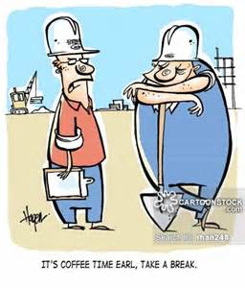
BREAK TIME – 10 MINUTES

Slide 27
The Claims Process
MWUA Claim Manager – Mike McGehee
In 2007, MWUA contracted with Boulder Claims as its third party administrator Boulder has handled in excess of 12,000 claims on behalf of MWUA and MRPIUA
Responsible for managing and supervising the entire claims process, development and communication of the MWUA catastrophe plan
Maintain a supervisory and managerial role throughout the claims handling process
Has dedicated staff to service all claims, non-catastrophic and catastrophic

Slide 28
The Claims Process (con’t)
Contract with Independent Adjusters to provide claims adjustment services to inspect and adjust a particular claim
Uses POD (Point of Delivery) concept for rapid expansion of claim examiner staffing.
Developed a panel of expert partners to provide key services
Engineers
Roofing consultants
Contractors

Slide 29
The Claims Process (con’t)
Independent Adjuster Panel
Boulder has agreements with eight national independent adjusting firms to provide in excess of 1,000 adjusters and examiners
Small Event (0-1000 claims): Will handle with staff and 1-3 firms
Medium Event (1000-2,500 claims): POD engagement and 3-8 firms
Moderate Event (2,500-8,000 claims): PODs (2-4) and all 8 firms
Major Event (8,000 – up): All PODs and all firms activated
POD examiner approach
Addresses the challenge of limited examiner resources and physical space shortage
Expand bandwith of examiner and supervisor resources
All PODs are supervised by Boulder Claims staff

Slide 30
Reporting A Claim
SurePower Website - Agents may use the Agent Portal to submit a Loss Notice. https://mwua.iscs.com/innovation
Policyholders may report claims via the Service Portal at :https://service-mwua.iscs.com
Phone - Call center is staffed 24 hours a day, seven days a week. Claims can be reported by calling 1-866-634-4465
Boulder Claims Website - Access to the claim reporting tool. http://www.boulderclaims.com
Email - claimsfax@boulderclaims.com or msfaxfnol@boulderclaims.com
Fax - New claims may be faxed to 1-877-786-7275

Slide 31
MWUA Application/ITV Review
Application Important Points
Effective Date – Not Bound until complete, paid, approved MW
Emergency Contact – Often skipped but important for claims
Fire Ins. Provider & Limit – wind limit no less than fire limit
Flood Information – Required if in any A or V zone
Valuation Intent – Replacement Cost or Actual Cash Value

Slide 32
Application/ITV Continued
Agency – Servicing agent is not MW agent, resident license req.
Binding provisions – Agent cannot guarantee binding eff. date
Cancellations – Fully Earned Premium Rule – 4 exceptions, Prop Sold, Total Loss, Placed Voluntary, & UW cancel for condition
Notices – Acknowledgement (Named Storm Deductible, Flood Coverage Requirement, Fully Earned Premium, Loss Settlement Provisions, Valuation intent ACV or RC). Important applicant understands.

Slide 33
Insurance to Value
Replacement Cost:
The cost to repair or replace with like kind and quality without deductions for depreciation. Replace new less deductible.
Actual Cash Value:
Replacement Cost less depreciation deductions for age, usage, and/or condition.
(Note – Real Estate Market Value does not apply to MW valuation. Most uniform property appraisals provide all 3
valuations (Real Estate Market, Replacement Cost, and
Depreciated value).

Slide 34
Loss Settlement Provisions
Important Points:
Personal Property/Contents and Structures that are not buildings are actual cash value depreciated value only. Other structures can be scheduled or considered part of the 10% of limit extension.
Scheduled buildings are valued by claims adjuster at the time of loss and if not within 80% of full replacement cost are subject to replacement cost coinsurance or actual cash value depreciated penalties. Application intent does not impact loss settlement provisions. Important for insured to understand this. Same for scheduled outbuildings.

Slide 35
Inspection Process/ITV
New Business Applications:
Application ITV Screening – economy, standard, custom
Follow up inspection – handling variances app to inspection
ITV variance process – new application versus inspection result
Renewal Updates:
General variance process – construction, zone, etc.
ITV variance process – different from new app variance approach – insured can defer to next renewal for correction

Slide 36
SUREPOWER POLICY SYSTEM
Rhonda Dunn - Underwriting Manager
Activity Tab - View, print, or email policies, endorsements, etc.
History Tab - How to view the policy period you want to see
Billing Screen - How to read premium paid, due, and who pays
Rating Worksheet – How to see premium rating information
Risk Tab – How to see the UW information for each location
Claim Tab – How to see updated claim information/status

Slide 37
Questions and Answers?
What are your questions regarding MWUA process and procedures?
What can MWUA do to improve operations?
Closing remarks – Brad Little
Thanks for attending this training session!!!

