Slide 1

Mississippi Windstorm Underwriting Association
Understanding the Rules and Processes 2019

Slide 2
BOARD OF DIRECTORS
3 agents with at least 10 years experience
  2 must be residents of the Coast
  1 must not be a resident of the Coast
5 assessable insurers
  Insurers that are authorized to write and engaged in writing property insurance within Mississippi on a direct basis.
2 Coast business leaders
The State Treasurer
11 Board Members

Slide 3
MWUA’s Mission
“Assure an adequate market for wind and hail insurance in the coast area of Mississippi.”
Protect policyholders state-wide from unreasonable windpool surcharges.
Avoid damaging the state-wide market for property insurance.
Encourage better building standards and land use in the coast area in order to mitigate wind losses and depopulate the Windpool.
While accomplishing these goals, try to avoid high rates thus helping the Coast economy revive.

Slide 4
Changes- Post Katrina
HB 1500 Signed into law changing MWUA .
HB 444 Signed into law amending elements of HB 1500 Provisions Effective 7-1-2019 with Insurer Assessment Formula Impact 2020.
* Geographic rating tiers – 5 rating zones
* Flood requirement for A and V zones
* Optional Deductibles – ( Minimum 2%, 5%, 10%, 15% & 20%)
* Fully Earned Premium Rule – Prevent Short Term Purchase
* No Servicing Carrier – Plans system/Plans staff administer

Slide 5
CHANGES CONTINUED
* Enhanced exposure data gathering to improve modeling
data – Update Inspections – Insurance to Value UW
  * Comm. Deductible Change- Application of % Deductible
* Discontinue MWUA Mitigation Program/ Now IBHS Applies
Amended Mandatory Evacuation Coverage
Manufactured/Mobile Homes – Fire Marshal Insp. Required
Dwellings/Mobile Homes – Application for Renewal Process
New Coverage Forms –Dwellings/Mobile Homes 2020

Slide 6
MWUA growth since 2005
August ‘05
16,155 polices
$1.8 billion insured
August ‘19
18,048 policies
$2.843 billion insured

Slide 7
MWUA
KATRINA LOSSES
16,155 policies in force
18,154 claims
$1.8 billion insurance in place
$720 million losses – 40% of Insured Limit
$175 million 2005 reinsurance in place
The remaining $545 million in MWUA losses were assessed to and paid by insurance companies.

Slide 8
Windpool Limit in ForceTrend Since Katrina

Slide 13
WHY the CHANGE in Dwelling Forms?
* Provide Value Certainty at Time of Loss
* Remove Coinsurance Penalties
* Limit Disputes at Time of Loss
* Further Clarify Insured Intent RCV/ACV
* Updates to Simplify Language
* Updates to stay current to ISO language
* Goal for Sufficient Coverage for a Loss

Slide 14
FORMS SPLIT RENEWAL TIMELINE
Begin release of agent/insured letters 120 days ahead of renewal policy expirations.
Receive Completed Renewal Applications < 90 days ahead of expirations.
MWUA Underwrites Applications Received.
MWUA Enters Approved Renewal Info < 60 days ahead of expirations.
Policy System Releases Quote 60 Days & Invoice 30 Days Ahead of Expiration.

Slide 15
Renewal Agent Notification Letter
Mailed 120 + Days Prior to Effective Date
Begins 11-1-2019 for 3-1-2020 Start
Provides Policy # , Eff Date, Insured Name
Provides Most Current UW File 100% RCV & ACV Calculated Values for Starting Point
Requires Documentation for a Limit less than Starting Point from UW file.

Slide 16
Renewal Insured Notification Letter
Mailed 120 Days + Prior to Expiration Date (2 days after release of Agent Letter).
Provides Policy #, Agent Name & Mailing Address
Provides Most Current UW File 100% RCV & ACV Calculated Values for Starting Point
Provides Notification of Coverage Changes, Notice of Nonrenewal & Requirement to Re-Apply – Explains.
Includes CC to the Policy Mortgage Interest.

Slide 17
Other Points – MWUA RENEWAL PROCESS
If MWUA Receives Application Properly Completed From Agent Prior to Release of Letters, MWUA will Not Send Letters.
If Application Is Received Prior to Release of Letters, MWUA Will Add the Notification of Coverage Change to the Insured’s Copy of the Renewal Quote/Expiration Notice.
Otherwise, Letters will be Mailed to the Agent & Insured 120+ Days Ahead of Expiration – Insured’s Copy Includes Notification of Coverage Change. Agents Copy Mails 2 Days Ahead of Insureds.
Agents Should Not Collect and Remit Premium – MWUA Will Release a Renewal Quote and Invoice Once the Renewal Application is Received, and Entered Into the Policy System.

Slide 18
RENEWAL PROCESS – IMPORTANT!
No Renewals Effective 3-1-2020 can be quoted without the Application For Renewal.
The Notification Letters to the Insured and Agent Include a Non-Renewal of Coverage Notice Requiring Re-Application For a Renewal Option.
Active Policies Eff. 3-1-2020 Forward Without An Application Will Be Nonrenewed

Slide 19
Abbreviated Renewal Application
Producing Agent, Address, Contact Info.
Applicant Name, Address, Contact Info (Email)
Location Address & Occupancy Info
Amount of Coverage – Building & Contents
Coverage Type Requested – RCV or ACV
Named Storm Deductible 2%, 5%, 10%, 15%, or 20%

Slide 20
Abbreviated Renewal Application (Cont.)
Non- Named Storm Deductible $500, $1,000, $2,500
Additional Interest/Mortgage Information
Emergency Contact Info- Address & Phone #
Fire Insurance Provider & Fire Coverage Amount
Flood Insurance Provider, Policy #, Expiration Date, Flood Zone
Insured Initials on Notice for Percentage Deductibles, Flood Coverage Requirements, Fully Earned Premium Rule, Loss Settlement Election RCV or ACV – Agent/Insured Signatures/Date

Slide 21
NEW BUSINESS TIMELINE
MWUA Programs Policy System for New Application Use 90 days ahead of the target 3-1-2020 Effective Date.
All New Submissions will Require the New Application for Policies Effective 3-1-2020 or Subsequent.
The New Business Application is the Full Version (Different from the Abbreviated Application for Renewal Version).

Slide 22
Notification of Changes Form - Highlights
Explains ACV & RCV Definitions – Clarifies Depreciation Applies to
Materials and Labor
Explains Choice is Required – Either RCV or ACV Form
Clarifies RCV Contemplates Like Kind, Quality & Use
Clarifies No Coverage for Trees, Shrubs, Plants, Lawns (Not a Change)
Clarifies Vacancy/Unoccupancy Does Not Void Coverage
Clarifies Treatment for Contents (Coverage C) for PPO
Clarifies Timeline For ALE Coverage for Civil Authority Evac. Order (Note Mandatory Evac Expense Coverage is a Different Issue)

Slide 23
Notification of Changes (Cont.)
Simplifies Rain, Water, Snow, Sleet Exclusion (same intent just simplified verbiage).
Added Exclusion for dam, levee, seawall, etc. failures.
Clarifies No Coverage for Intentional Property Damage.
Clarified 60 Day Timeline for Loss Inventory & Receipts for Additional Living Expenses Incurred
Provides that Rankin County is Jurisdiction for Court

Slide 24
Notification of Changes – Cont.
  Removed Reference to Commercial in Dwelling Form
  Clarifies Installed Carpet is Treated as Building when RCV Coverage is Selected.
  Allows for Rebuild at New Location for Like Kind, Quality & Use (Not Required to rebuild @ Original Location).
  Requires Repair, Replace or Notification of Intent Within 180 days of loss (Mike McGehee will Explain).
  Removes Coinsurance Clause Completely

Slide 25
NEW DWELLING COVERAGE FORMS
MWUA RCV 001 07/19 – Requires 100% RCV Policy Limit If Selected.
MWUA ACV 001 07/19 – Requires 100% ACV Policy Limit if Selected.
New Dwelling Forms Choice Applies to New and Renewal Policies Effective 3-1-2020 and Subsequent. Coinsurance Eliminated.
Copies of the Forms are Posted on the MWUA Website – Forms Section and Current News Section Along with the Notification of Change Document, Renewal Application, and New Application.

Slide 26
MWUA Application/ITV Review
New Application Important Points
Effective Date – Not Bound until complete, paid, approved MW
Emergency Contact – Often skipped but important for claims
Fire Ins. Provider & Limit – wind limit no less than fire limit
Flood Information – Required if Risk Located in an A or V zone
Valuation Intent – RCV or ACV Choice Required

Slide 27
Application/ITV Continued
Application Conditions/Notices:
Agency – Servicing agent is not MW agent, resident license req.
Binding provisions – Agent cannot guarantee binding eff. date
Cancellations – Fully Earned Rule, 4 exceptions
Notices – Acknowledgement (Named Storm Deductible, Flood Coverage Requirement, Fully Earned Premium, Loss Settlement Provisions). Important applicant understands.

Slide 28
Insurance to Value
Replacement Cost:
The cost to repair or replace for like kind, quality, and use without deductions for depreciation. Replace new less deductible.
Actual Cash Value:
Replacement Cost less depreciation deductions for age, usage, and/or condition. Depreciation applies to Labor.
(Note – Real Estate Market Value does not apply to MWUA valuation. Most uniform property appraisals provide all 3
valuations (Real Estate Market, Replacement Cost, and Actual Cash Value depreciated value).

Slide 29
Documentation For Review
Cost Estimators with detailed information – Summary Views Do Not Work for Variance Review Against Inspection Calculation Reports.
Contractor Estimates – Reasonably Current & Detailed
Uniform Property Appraisal Reports – Reasonably Current
Fire Policy Limits Considered if Match on Valuation Approach - Current Declaration Page/Valuation Basis Provided to Compare.

Slide 30
Loss Settlement Provisions
Important Points:
Personal Property/Contents and Structures that are not buildings are actual cash value depreciated value only. Other structures can be scheduled for a specific limit, or considered part of the 10% of Coverage A limit (but this does not increase limit).
Coinsurance Penalties Apply to Current Policies but Effective 3-1-2020 for new and renewal policies, coinsurance penalties will be eliminated. The Claim presentation will cover coinsurance issues on Current Policies.

Slide 31
Inspection Process/ITV
New Business Applications:
Application ITV Screening – economy, standard, custom
New Business Inspection – completed within 30 days of bind
ITV Variance – resolve application versus inspection differences
Renewal Inspection Updates (every 4th year)
Includes ITV, Construction, and Other Variance Reviews
Resolved Variances endorsed mid term on NEW, Next term quotation for RENEWALS (Insured can request mid term)

Slide 32

Break – 10 Minutes

Slide 33
IBHS & SMART HOME AMERICA
FORTIFIED HOME PRESENTATION

Slide 34
The Claims Process
  MWUA Claim Manager – Mike McGehee
  In October2018, MWUA contracted with U.S. Adjusting Services as its third party administrator. U.S. Adjusting Services has handled approximately 300 claims on behalf of MWUA and MRPIUA based in Irving, TX.
  U.S. Adjusting Services was founded in 1983 as Hamilton Catastrophe Claims and is a 100% minority owned business.
  Responsible for managing and supervising the entire claims process, collaboration and communication of the MWUA catastrophe plan.
  Maintain a supervisory and managerial role throughout the claims handling process- Field Adjusters, Examiners, Call Center.
  Has dedicated staff to service all claims for non-catastrophic and catastrophic events.
  Maintains the MS Plans call center 24/7 365 days a year.

Slide 35
The Claims Process (con’t)
  U.S. Adjusting services maintains a roster of their own Adjusters (500), Examiners (75) and Trainers (37)
  Contracts with Independent Adjusters to provide claims adjustment services to inspect and adjust a particular claim
  Uses POD concept for rapid expansion of claim examiner staffing.
  Developed a panel of expert partners to provide key services
    Engineers
    Roofing consultants
    Contractors
    Ladder assist

Slide 36

The Claims Process (con’t)
Independent Adjuster Panel
U.S. Adjusting has agreements with three national independent adjusting firms to provide in excess of 500 Adjusters and Examiners
  Small Event (0-1000 claims): Will handle with staff adjusters
  Medium Event (1000-2,500 claims): Staff, POD engagement and 2 firms
  Moderate Event (2,500-8,000 claims): Staff, PODs (2-4) and all firms
  Major Event (8,000 – up): All staff, PODs and all firms activated
Training and Certification
“Real World Training In Our Real World Facility”
Catastrophe Adjuster Training Institute
14,000-square foot facility which showcases 30+ damage and material mockup structures
  Certified Xactimate trainers
  Hands on property training facility.
  CATI has already held three MS Plans Certification training classes in Jackson and Irving Texas
  All field Adjusters and Examiners are to be Certified through rigorous testing and examination

Slide 37
Reporting A Claim
Surepower /Insurance Now Policy system - Agents may use the Agent Portal to submit a Loss Notice. https://mwua.iscs.com/innovation
Phone - Call center is staffed by U.S. Adjusting Services 24 hours a day, seven days a week.
Claims can be reported by calling 1-866-634-4465
Email - newclaims@msplans.com or msclaimsdocs@msplans.com
Fax - New claims may be faxed to 1-877-786-7275
Claim Information brochure sent to agents and insureds

Slide 38
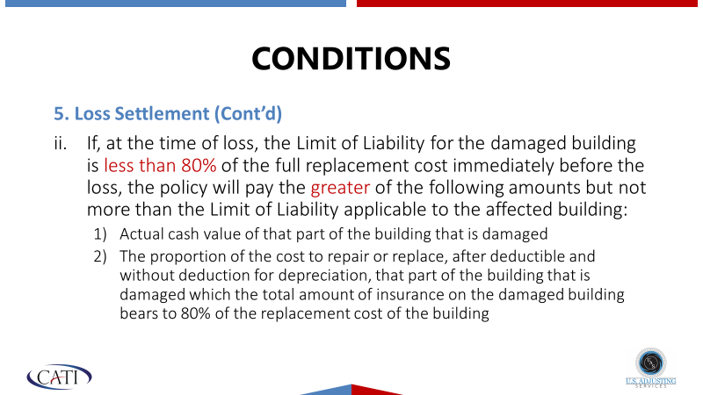
Current Dwelling Form Claim Process

Slide 39
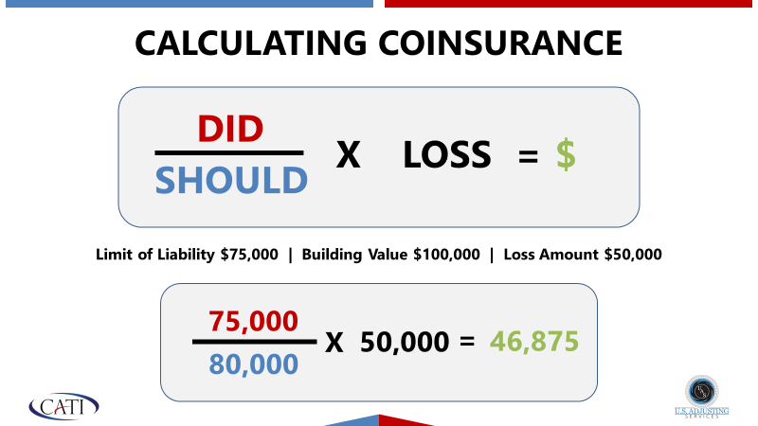
Current Dwelling Form Claim Process (con’t)
Current MWUA policies are RCV policies with an 80% co-insurance clause
Adjusters complete an ITV evaluation at the time of the loss through Xactimate. Uses same platform as 360 Value
  Checks values for underwriting
  Determines if risk is insured to value
    A penalty applies if the risk is not insured to 80% or greater (Formula is used).

Slide 40
Current Dwelling Claim Process (cont.)
If the risk is not insured to 80% value at time of loss, Insured receives the greater of the two penalty payment calculations:
  RCV less depreciation = ACV loss - less the deductible -with no chance to recover depreciation withheld
  RCV adjusted by co-insurance percentage penalty - less the deductible
  Example – Time of Loss RC value $100,000 – Policy Limit $45,000 – Depreciation 49%
  Depreciation Penalty - Gross repair $8,314.69 less $4,240.49 (depreciation) less $1000 deductible = $3,074.20 payment (with no chance to recover depreciation)
  Coinsurance Penalty -$100,000 X 80% = $80,000 Coinsurance Required coverage
  $45,000 limit carried/$80,000 80% coinsurance required = 56% (equates to 44% penalty)
  Gross repair amount: $8,314.69 X 56% = $4,656.22 (with penalty applied)
  $4,656.22 less $1,000 Deductible = $3,656.22 payment
  Coinsurance Penalty is best for insured and is the applied penalty for underinsurance at time of loss.

Slide 41
NEW Dwelling Forms – RCV or ACV Form
  Updated RCV and ACV policy Definitions
  Actual Cash Value” means replacement cost less depreciation, which includes depreciation of materials and labor used to calculate replacement cost.
  “Depreciation” means deductions to labor and materials, based on age, usage, wear and tear, condition, and other similar factors.
  “Replacement Cost” means the cost for materials and labor to repair or replace with like kind and quality and for like use without deductions for depreciation.
  Important! - On RCV, a depreciation hold back is applied until repair or replacement is complete.

Slide 42
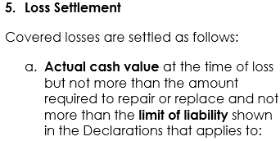
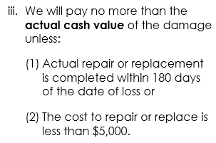
New RCV Form
New RCV form Loss Settlement provisions
Co-Insurance clause is removed
Claims remain settled on an ACV basis (RCV loss less Depreciation)
Insured receives an initial ACV payment
Insured can recover depreciation withheld if repair or replacement is complete, or notification to MWUA of your intent to repair or replace the damaged or destroyed structure within 180 days of the date of loss.

Slide 43
New Forms – Comparison RCV vs ACV – No Coinsurance
RCV form payment method
$8,314.69 repair cost
($4,240.49) less recoverable depreciation (49% Depreciation Applied)
($1,000) less deductible
$3,074.20 initial payment
$4,240.49 payment when repairs/replacement completed
$7,314.69
ACV form payment method
$8,314.69 repair cost
($4,240.49) less non-recoverable depreciation (49% Depreciation Applied)
($1,000) less deductible
$3,074.20 payment

Slide 44
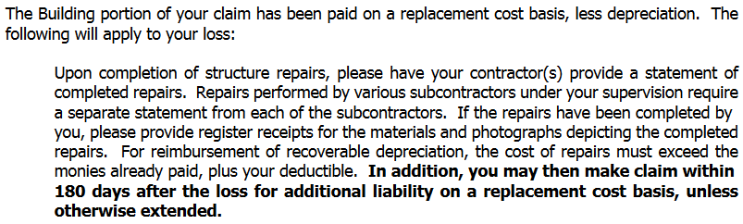
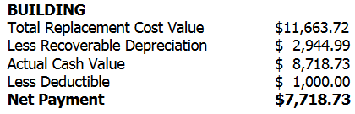
RCV Form – Depreciation Holdback
Insured receives a Settlement Letter
Settlement Letter is sent to the insured that contains the following paragraph

Slide 45
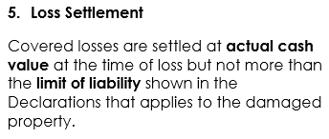
ACV form
New ACV form Loss Settlement provisions
Claims are settled on an ACV basis (RCV loss less Depreciation)
Insured receives an initial ACV payment
There is no other recovery or follow up payment

Slide 46
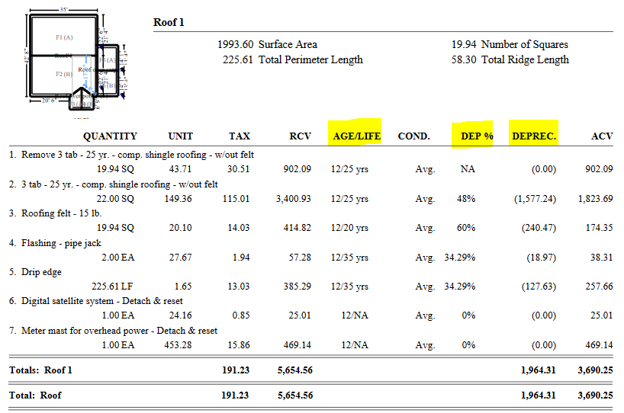
Depreciation is Calculated in Xactimate

Slide 47
Questions and Answers?
What are your questions regarding MWUA process and procedures?
What can MWUA do to improve operations?
Closing remarks
Thanks for attending this training session!!!

